Slide 1
Introduction to Macro Economic Principles
Dr Sophia Kuehnlenz
s.kuehnlenz@mmu.ac.uk
Lecture week 1

Slide 2
General information
Unit leader
Tutorial Leaders
Dr Sophia Kuehnlenz (s.kuehnlenz@mmu.ac.uk)
Office hour: Wednesday, 13.45 – 14.45
Office: BS 6.31
Utilise those office hours
Talk to us if you struggle (often it’s just little things)
Dr Tidings Ndhlovu (tidings.ndhlovu@mmu.ac.uk)
Office hour: Wednesday, 14:00-15:00 (virtual)
Office: BS 6.32
Dr John Simister (j.g.simister@mmu.ac.uk)
Office hours: Monday, 13.00-14.00pm; Tuesday, 13.00-14.00pm
Office: BS 6.34
The main text for this unit:
The Core Team (2017). The Economy: Economics for a changing World (1.0). Oxford: Oxford University Press.
You can access the book for free online
Which unit you need to read for the week will be under each week on Moodle.
Complementary material that may be of help:
The Core Team (2019). Economy, Society, and Public Policy. Oxford: Oxford University Press.
You can access the book for free online

Slide 3
General information
Lecture
1h long
Each Wednesday (check your TT for the room)
Will be recorded
Tutorials
1.5 hours long
Each Wednesday and Friday (check your TT for room)
Come prepared – this is how we can give you feedback on your work
It is not a second lecture
You need to do the work
Each week will have a section called Take-Away on Moodle
Main points to focus on
Each week will be accompanied by a video
Aim: get you thinking critically about concepts in this unit

Slide 4
General information
Against the backdrop of the polycrisis
Unit is split into two parts
Theory (weeks 1-5):
Economic theory explaining (or trying to explain) economic fluctuations
We will look at the industrial revolution (briefly)
We will look at GDP and its components in detail
  Via equations and models
We will look at theoretical explanations of interconnected variables (e.g. GDP growth, inflation and unemployment levels) using specific economic theories and approaches
We will look at policy choices to address fluctuations
Application (weeks 7-10):
We will look at actual data to check whether the economic theories hold and/ or can explain economies
We will look that this critically to evaluate the validity of theories and calculations
Focus will be (mostly) on the UK

Slide 5
Assessment
2 parts – MCQ (20%) and written assignment (80%)
Details on Moodle
MCQ:
  31st October 2025
  You have 2 hours for 20 randomly chosen questions
  Four answers per question – only one is correct
  Start: 2.00 pm
  End: 8.00 pm
  Use the MCQ to build “points” towards the assessment
Assignment:
  Deadline: 12th December at 9.00 pm
  You should be able to start writing on the theoretical section after week 5
  Detail is key
Have a look at the assessment brief to ensure you know what to do and what is expected for the written assignment

Slide 6
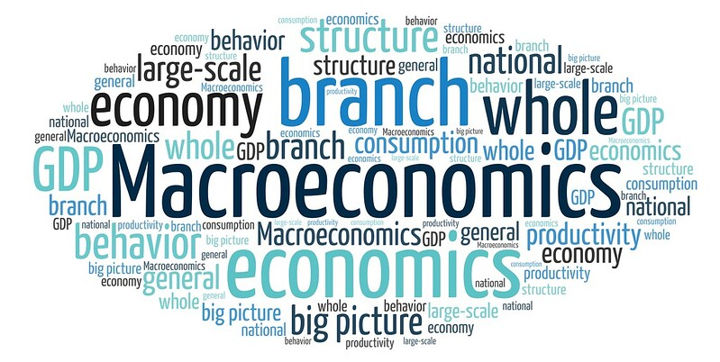
What is macroeconomics?
The big picture
Whole of the economy - aggregates (nationally and internationally)
  GDP growth, inflation, investment, unemployment, economic fluctuations and crises, role of institutions, inequality…
  What would you add?
Notes:
Source: https://www.flickr.com/photos/182229932@N07/48357051187

Slide 7
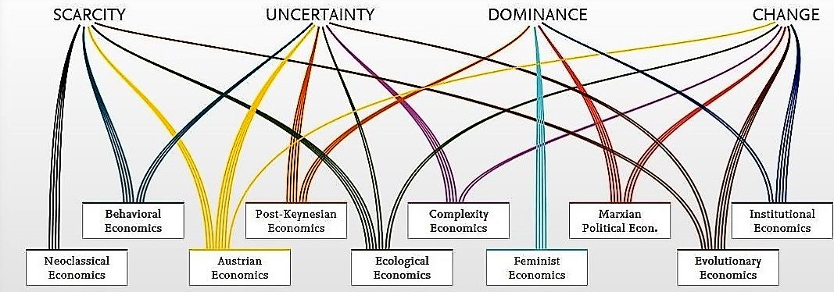
Two ways of looking at the economy: Mainstream and heterodox
https://www.exploring-economics.org/en/orientation/#compare

Slide 8
Unit 1
THE CAPITALIST REVOLUTION

Slide 9
What we will talk about today
Economic inequality and divergence
The technological revolution and growth
The role of capitalism in economic growth
Importance of the government in capitalist economies

Slide 10
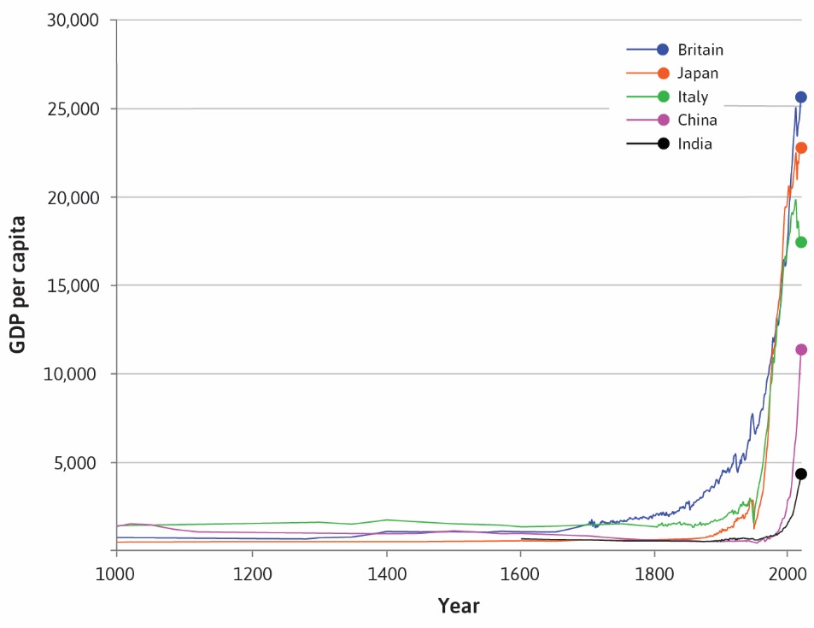
What we will try to explain:
Rapid, sustained growth in average living standards since 1700.
How did this happen?

Slide 11
Measuring income and living standards
Gross Domestic Product (GDP) = A measure of total income and output of the economy in a given period.
Usually expressed in per-capita terms (as an average income).
  Per-capita income: GDP divided by a country’s population → issues?
  Can you measure wellbeing and standard of living in that way?
GDP per capita ≠ Disposable income

Slide 12
Measuring income and living standards
Disposable income = Total income – taxes + government transfers
  A good measure for wellbeing?
  Is all of our wellbeing related to what we can buy?
Both are imperfect measures of well-being

Slide 13
“Hockey-stick” growth

Slide 14
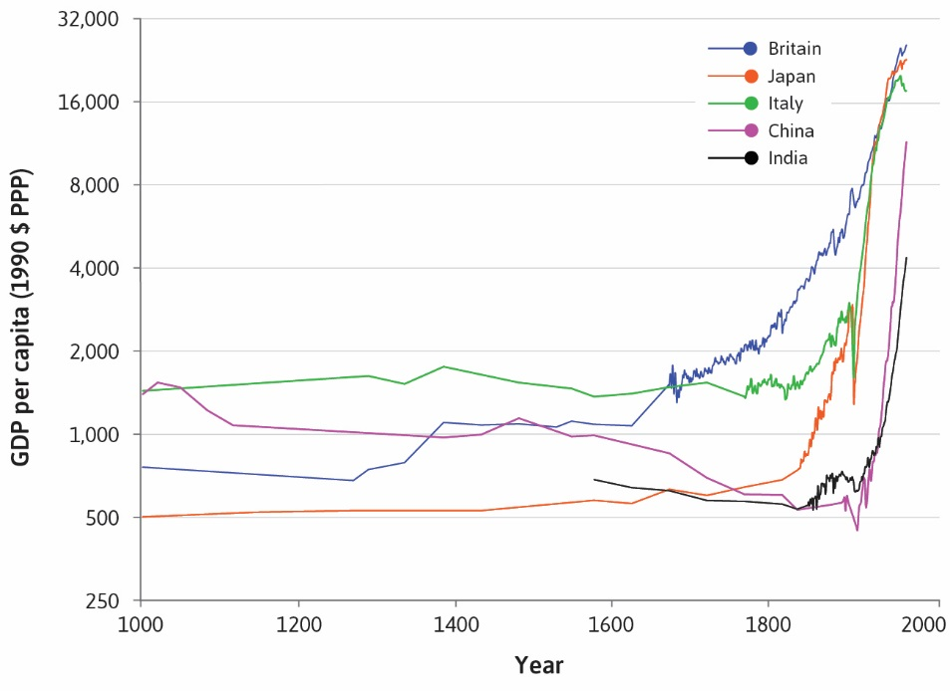
GDP growth rates
“Hockey-stick” curves represent the sustained rapid growth in GDP per capita experienced by countries worldwide.

Slide 15

GDP growth rates
What we learn from the figure:
Growth rates in Japan, China and India were higher than elsewhere (the curves are steeper)
For a very long time, living standards did not grow in any sustained way.
When sustained growth occurred, it began at different times in different countries, leading to vast differences in living standards around the world
In some economies, substantial improvements in people’s living standards did not occur until they gained independence from colonial rule or interference by European nations.

Slide 16
What could be the explanation for this “suddenly occurring“ rapid growth?

Slide 17
The Industrial Revolution
Industrial Revolution = a wave of technological advances starting in Britain in the 18th century, which transformed an agrarian and craft-based economy into a commercial and industrial economy.
Technological revolution tied to capitalist revolution
Application of new technologies (steam engine, electricity, transportation, IT)
  Innovation did not end with the Industrial Revolution
  Changed the way economies work – increase standard of living
  Transformation of societies (from farmer to worker)
  Capitalism

Slide 18
How can you explain the stagnation before the industrial revolution?
Malthus’ Law:
Population expands if living standards increase
But as more people work on the land, their income will inevitably fall
Higher population and decreasing living standards
But with technological revolution, capitalist revolution more can be produced with greater efficiency (e.g. specialization)
→ Introduction to Microeconomic Principles

Slide 19
Capitalism

Slide 20
Key Concepts defining Capitalism
Private property = ownership rights over possessions
An important type of private property is capital goods = the non-labour inputs used in production (buildings, machines, raw materials).
Does not include some essentials, e.g. air, knowledge
Markets = a way for people to exchange products and services for their mutual benefit. Unlike other types of exchange, markets
Are reciprocated transfers (both sides involved in exchange)
Voluntary (transaction beneficial for both, buyers and sellers)
Usually there is competition (not just one seller/buyer)

Slide 21
Key Concepts defining Capitalism
Firms = business organization (owned by one or more individuals) that uses inputs to produce outputs, and sets prices to at least cover production costs.
Inputs and outputs are private property (of the owners)
Firms use markets to sell outputs
The aim is usually to make profit
They pay wages and salaries to employees
They direct the employees (through the managers they also employ) in the production of goods and services

Slide 22
The Capitalist Revolution
Capitalism led to growth in living standards because of:
Impact on technology: firms competing in markets had strong incentives to adopt and develop new technologies
Specialization: the growth of firms and the expansion of markets linking the entire world allowed historically unprecedented specialization in tasks and production
Together with the technological revolution, this increased worker productivity.

Slide 23
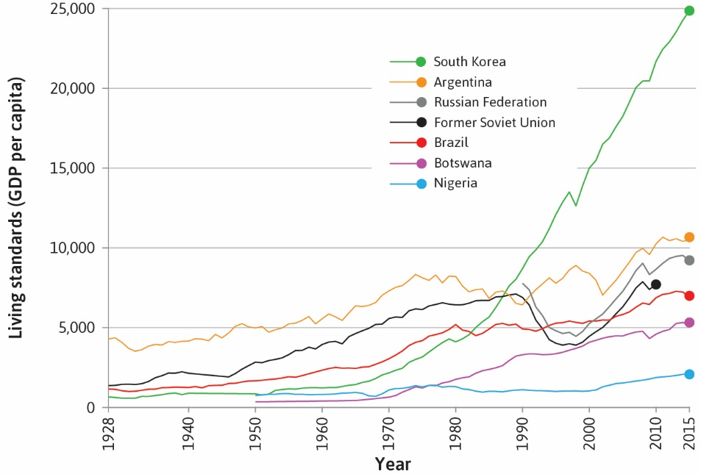
Divergence in growth
Not all capitalist economies are equally successful
Two sets of conditions influence success:
  Economic conditions: firms, private property, or markets may fail
  Political conditions: capitalist institutions are regulated by the government
→ The government also provides essential goods and services (infrastructure, education)

Slide 24
Explanations for divergence in growth:
Economic conditions
Private property is not secure:
  Weak enforcement of the rule of law and of contracts
  Expropriation either by criminal elements or by government bodies
Markets are not competitive:
  No incentive to be (cost) efficient and innovative
  Underperforming firms continue to exist
Firms are owned and managed by people who survive because of their connections to government or their privileged birth:
  They did not become owners or managers because they were good at delivering high-quality goods and services at a competitive price. The other two failures would make this more likely to occur.

Slide 25
Explanations for divergence in growth: Political conditions
Government is important
Large part of the economy, accounting for more than half of GDP
Establish, enforce and change the laws and regulations that influence how the economy works
Enforce the property rights necessary for markets to work
Supports the institutions of capitalist economy
Provides essential goods and services such as physical infrastructure, education and national defence

Slide 26
Capitalism and Inequality

Slide 27
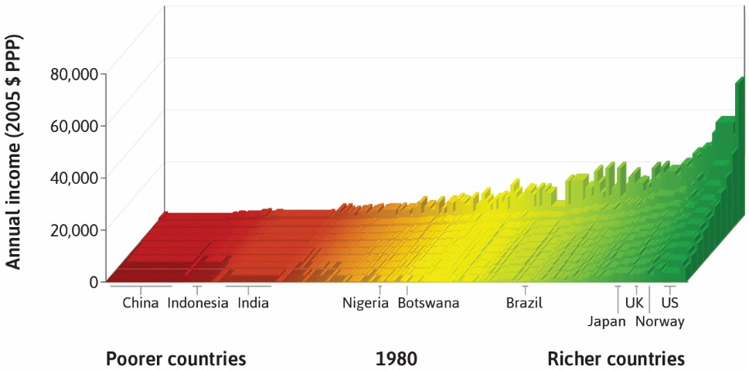
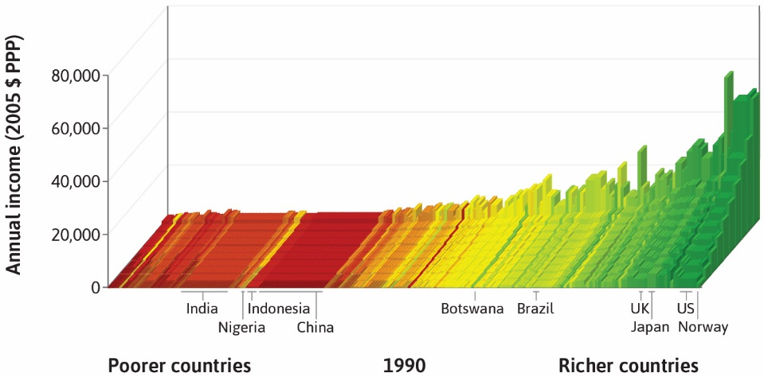
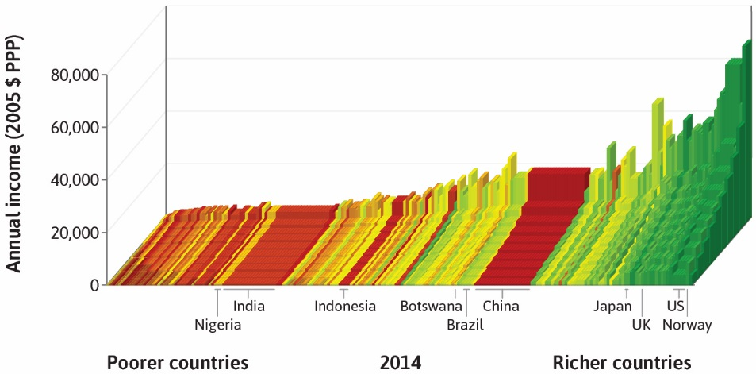
How unequal is the world?
1980
1990
2014
When looking at these graphs and the evolution of inequality since the 1980s, what can you say?

Slide 28
Within and between country inequality
1,000 years ago, the world was “flat”. Today, there are large differences both within and across countries.
Over the past two decades, global inequalities between countries have declined (World Inequality Report, 2022)
Inequality within countries has increased dramatically (degree depends on the region: US, UK, Asia, vs. mainland Europe vs. Sub-Saharan countries)

Slide 29
The Capitalist Economy and the Environment

Slide 30
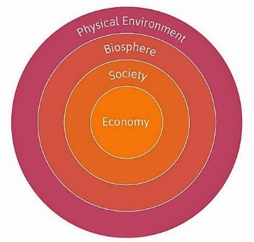
The economy and the Environment
One way of thinking about the economy:
It is part of a larger social system, which is itself part of the biosphere
People interact with each other, and also with nature, in producing their livelihood
As production has soared so have the use of our natural resources and degradation of our natural environment

Slide 31
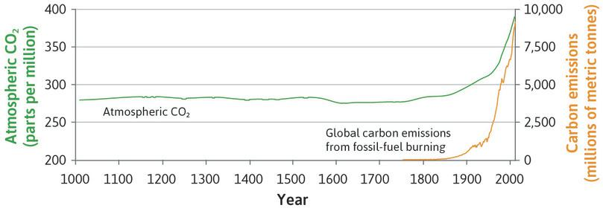
Environmental consequences
The use of fossil fuel (coal, oil, and natural gas) has profoundly affected the natural environment
Increasing emissions of carbon dioxide (CO₂) into the air during the twentieth century have resulted in measurably larger amounts of CO₂ in the earth’s atmosphere
CO₂ emissions from fossil fuel consumption have risen dramatically since 1800

Slide 32
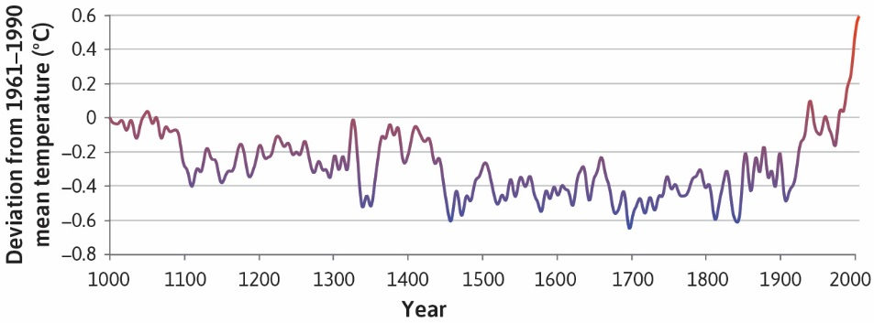
Environmental consequences
Increased production and population growth affects the environment
Global impacts – climate change
  Since 1900, average temperatures have risen in response to increasingly high levels of greenhouse gas concentrations (mostly resulted from the CO₂ emissions associated with the burning of fossil fuels)
Local impacts – pollution in cities, deforestation

Slide 33
Environmental consequences
These effects are results of both
The expansion of the economy (illustrated by the growth in total output)
The way the economy is organized (what kinds of things are valued and conserved, for example).
The permanent technological revolution may also be part of the solution, by making it possible to use less resources to produce more output.
What do you think?

Slide 34
Summary
Important trends in economic variables over time
Income inequality within countries has increased a lot over time
“Hockey-stick” growth in GDP, and its negative consequences
Technological progress helped bring about these trends
2. The adoption of capitalism was another key factor
Capitalism = Private property + Markets + Firms
Failure of these institutions can explain divergence in economic growth across countries
Political systems and the role of government also determine the type of capitalist society

Slide 35
Next week
A closer look at financial markets: the banking system, actors, instruments
A first look at balance sheets
Money: functions, types, risk
Endogenous money creation: banks create money in the process of supplying credit

